Slide 1

BTP phase 2
Modelling and simulation of incremental sheet metal forming
Group Members Supervisor
Kumara Swamy B S DR Uday Shanker Dixit
(200103131) (Department of Mechanical Engineering)
Neeraj Kumar
(200103136)

Slide 2
Plan of Presentation
Introduction
Literature Review
Motivation and Objective of the Work
Numerical Formulations
Results and Conclusions
Upcoming / Future Work
References

Slide 3
Introduction
Simulation modelling is a computer-based technique that involves creating a digital model of a system, which allows users to experiment and analyze complex problems.
It is highly customizable, allowing users to adjust parameters, add or remove components, and change inputs to test different scenarios and evaluate the impact of decisions on the system being modelled.
Simulation modelling is also highly visual and easy to understand, making it an effective tool for communicating complex ideas to stakeholders and decision-makers.

Slide 4
Literature Review
Sheet metal forming is a complex manufacturing process used to make a wide range of products. The process involves many variables, such as material properties, tool geometry, and forming forces.
Modelling and simulation can help improve understanding and optimize process parameters. A recent research paper presents an analytical model to predict forming force in typical incremental sheet forming processes.
The model considers material properties, tool geometry, and forming parameters, and the authors conduct experiments to validate the model.
This project aims to develop a code in C++ and Python to calculate forming forces for different sheet metal forming processes and incorporates additional features such as user inputs for sheet metal properties and tool geometry.

Slide 5
Motivation
Motivation for this project is to make analysis simpler and less cumbersome by developing the code to get the different forces in different process within seconds. It will save time and effort!
Objectives
This project aims to study and understand the research paper on "Analytical modelling and experimental validation of the forming force in several typical incremental sheet forming processes" by Zhidong Chang and his team.
The project further aims to develop a code in C++ and Python that can calculate forming forces for different sheet metal forming processes, validate the code, investigate the effects of different parameters on forming forces, and analyze the potential for process optimization using the developed code and simulation results.

Slide 6
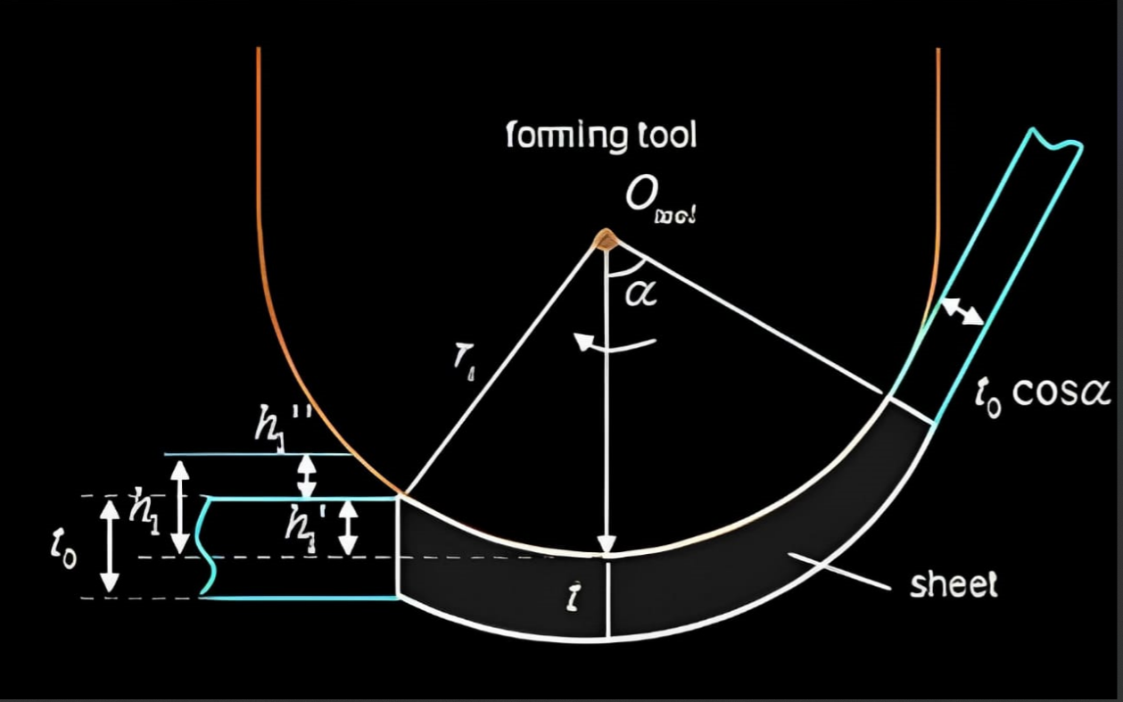
Numerical Formulations
The research paper on incremental sheet metal forming was reviewed, which presented a comprehensive analytical model for predicting the forming force in several typical processes.
The model was validated through experiments and was found to be more accurate than a previous model proposed by Aeren.
The authors focused on SPIF (Single pass incremental forming), MPISF (Multi pass incremental sheet metal forming), IHF (Incremental hole flanging) processes and analyzed four main parameters, including wall angle, step depth, tool radius, and sheet thickness, for SPIF.
Forming force modelling of SPIF:
The four main parameters are,
Wall angle(α), Step depth(h), Tool radius(r),
Sheet thickness(t_{o})

Slide 7
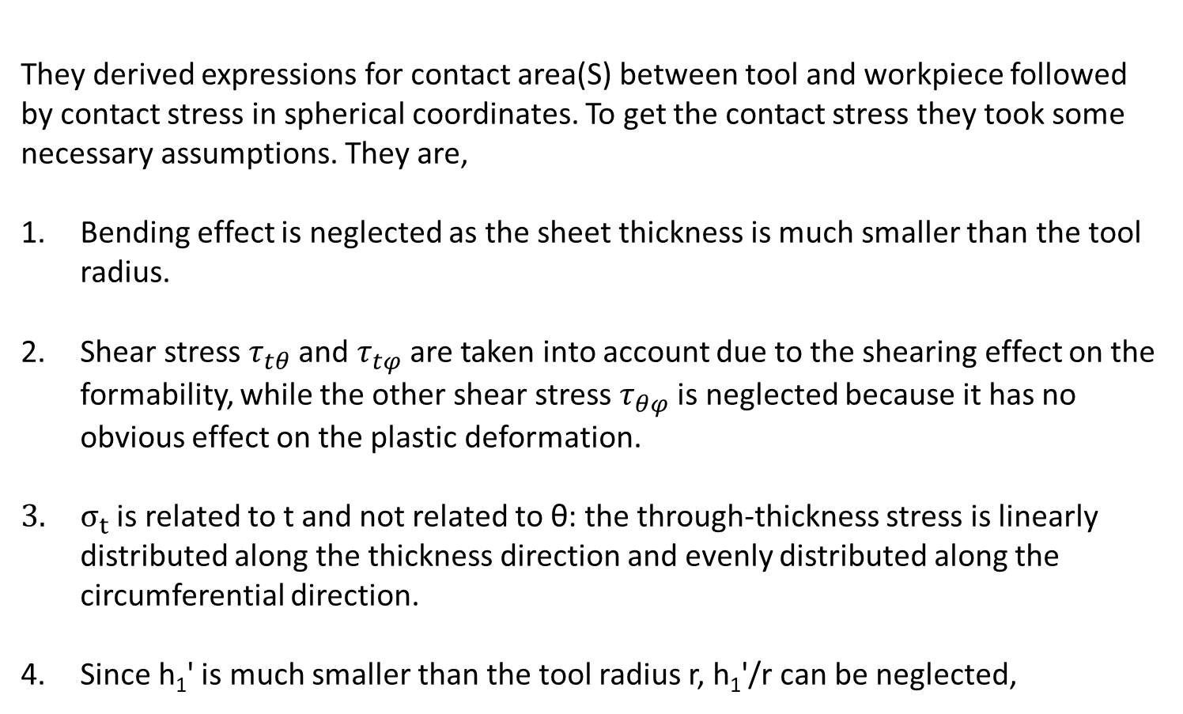
They derived expressions for contact area(S) between tool and workpiece followed by contact stress in spherical coordinates. To get the contact stress they took some necessary assumptions. They are,
Bending effect is neglected as the sheet thickness is much smaller than the tool radius.
Shear stress $τ_{tθ}$ and $τ_{tφ}$ are taken into account due to the shearing effect on the formability, while the other shear stress $τ_{θφ}$ is neglected because it has no obvious effect on the plastic deformation.
$σ_{t}$ is related to t and not related to θ: the through-thickness stress is linearly distributed along the thickness direction and evenly distributed along the circumferential direction.
Since h₁' is much smaller than the tool radius r, h₁'/r can be neglected,

Slide 8
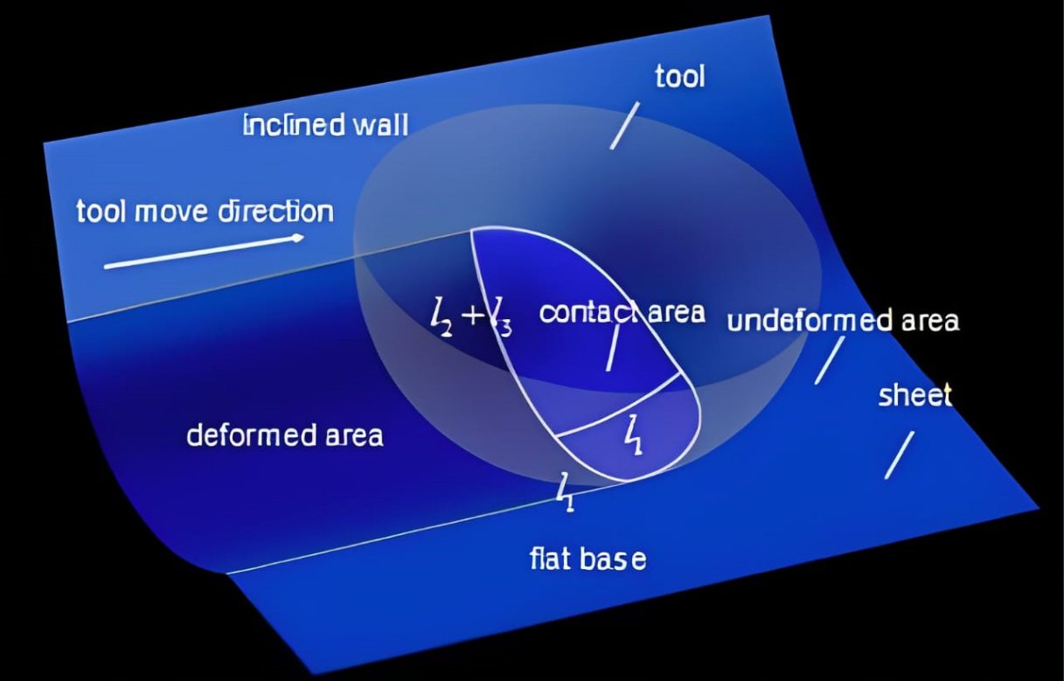
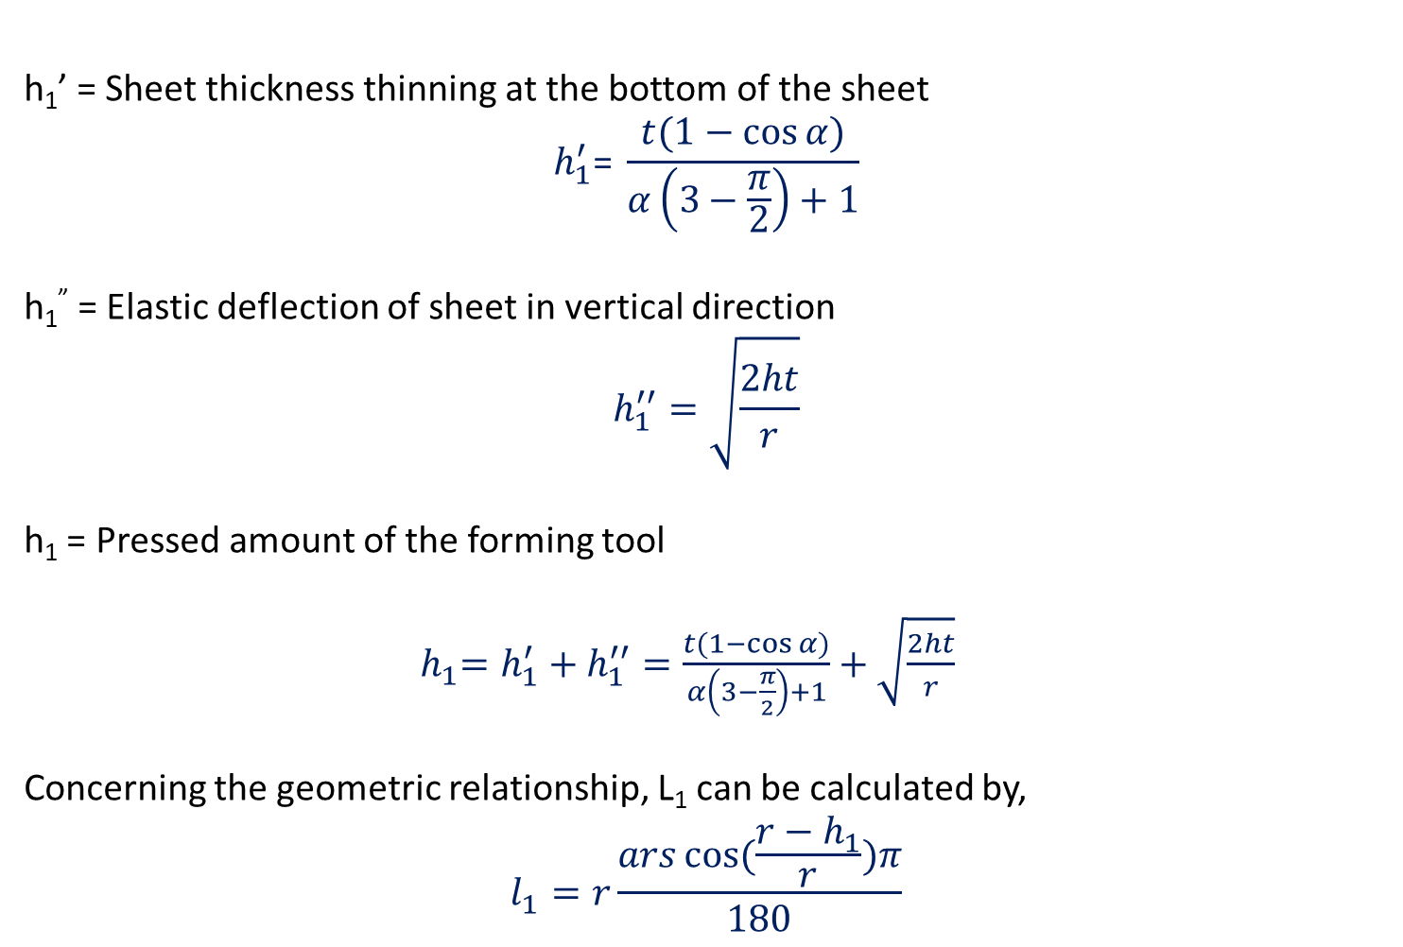
h₁’ = Sheet thickness thinning at the bottom of the sheet
$$h_{1}^{′}\text{= }\frac{t(1−\cos{α)}}{α\left(3−\frac{π}{2}\right)+1}$$
h₁” = Elastic deflection of sheet in vertical direction
$$h_{1}^{′′}=\sqrt{\frac{2ht}{r}}$$
h₁ = Pressed amount of the forming tool
${ h}_{1}=h_{1}^{′}+h_{1}^{′′}=\frac{t(1−\cos{α)}}{α\left(3−\frac{π}{2}\right)+1}+\sqrt{\frac{2ht}{r}}$
Concerning the geometric relationship, L₁ can be calculated by,
$$l_{1}=r\frac{ars\cos{(\frac{r−h_{1}}{r})π}}{180}$$
Three-dimensional perspective view

Slide 9
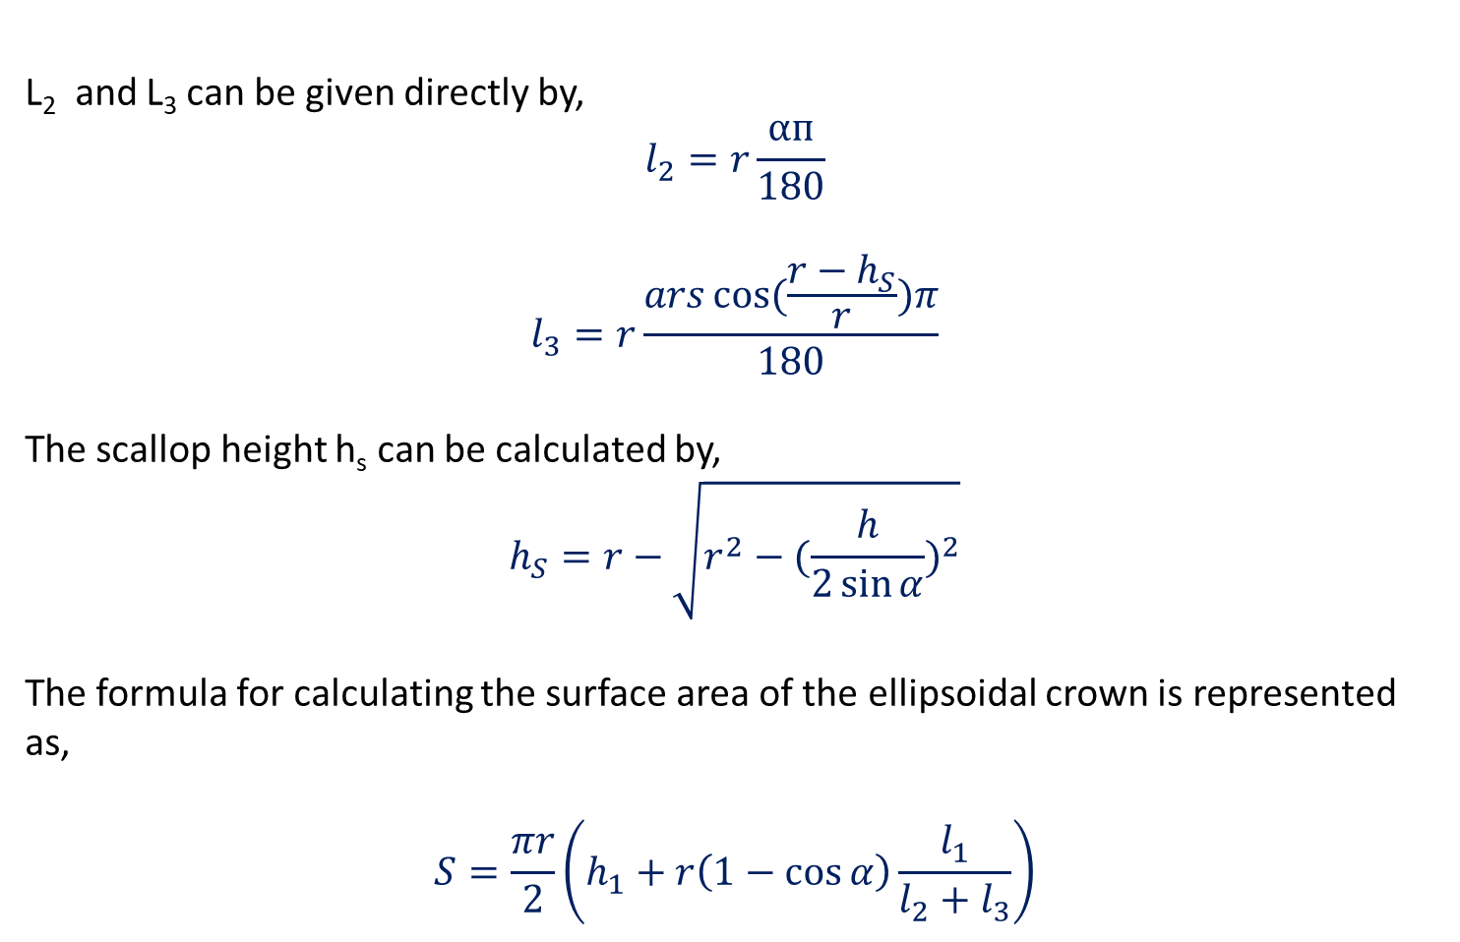
L₂ and L₃ can be given directly by,
$$l_{2}=r\frac{αᴨ}{180}$$
$$l_{3}=r\frac{ars\cos{(\frac{r−h_{S}}{r})π}}{180}$$
The scallop height h_{s} can be calculated by,
$$h_{S}=r−\sqrt{r^{2}−{(\frac{h}{2\sin{α}})}^{2}}$$
The formula for calculating the surface area of the ellipsoidal crown is represented as,
$$S=\frac{πr}{2}\left(h_{1}+r\left(1−\cos{α}\right)\frac{l_{1}}{l_{2}+l_{3}}\right)$$

Slide 10
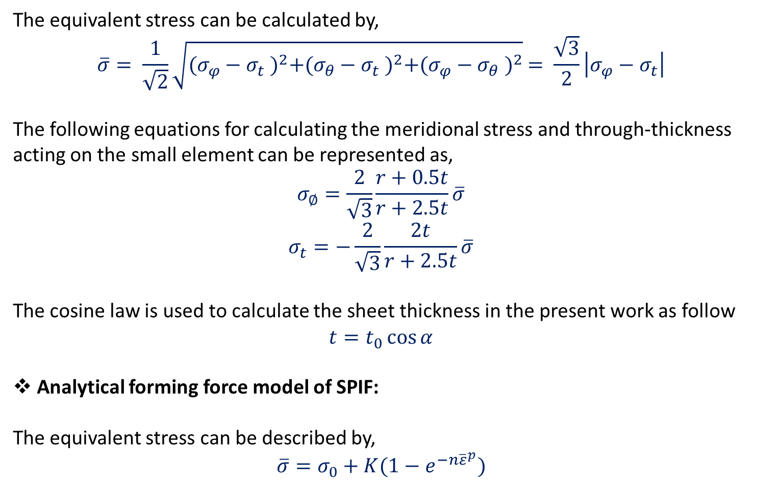
The equivalent stress can be calculated by,
$$\overline{σ}= \frac{1}{\sqrt{2}}\sqrt{{(σ_{φ}−σ_{t} )}^{2}+{(σ_{θ}−σ_{t} )}^{2}+{(σ_{φ}−σ_{θ} )}^{2}} = \frac{\sqrt{3}}{2}\left|σ_{φ}−σ_{t}\right|$$
The following equations for calculating the meridional stress and through-thickness acting on the small element can be represented as,
$$σ_{∅}=\frac{2}{\sqrt{3}}\frac{r+0.5t}{r+2.5t}\overline{σ}$$
$$σ_{t}=−\frac{2}{\sqrt{3}}\frac{2t}{r+2.5t}\overline{σ}$$
The cosine law is used to calculate the sheet thickness in the present work as follow
$$t=t_{0}\cos{α}$$
Analytical forming force model of SPIF:
The equivalent stress can be described by,
$$\overline{σ}=σ_{0}+K(1−e^{−n{\overline{ε}}^{p}})$$

Slide 11
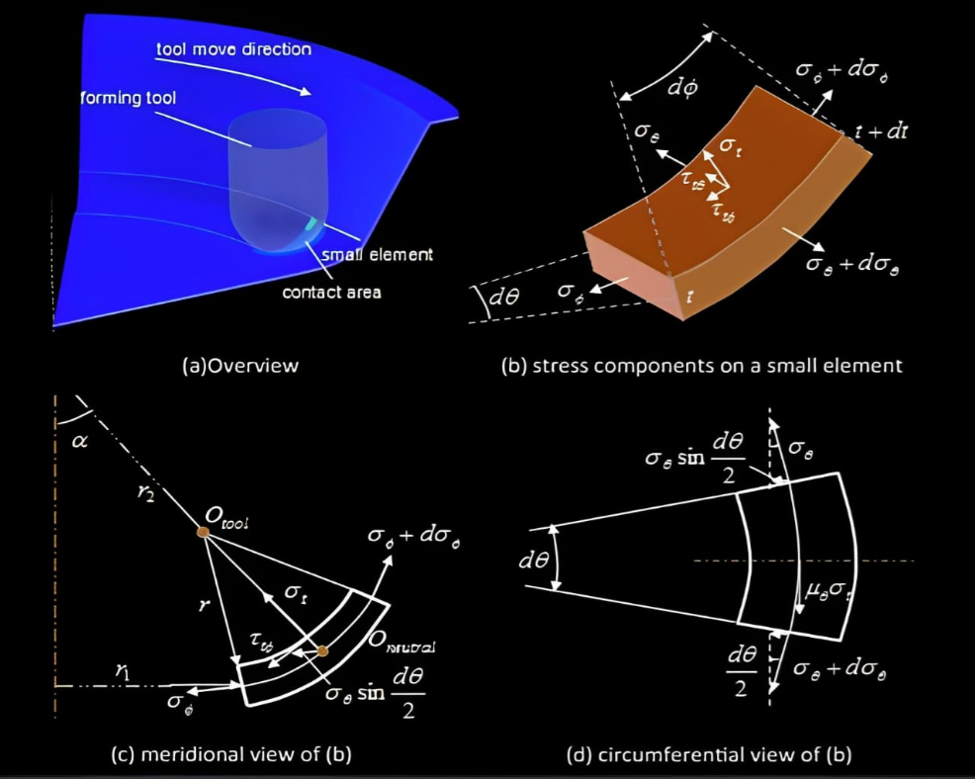
Schematic representation of ISF forming (inspired by Silva et al.)

Slide 12
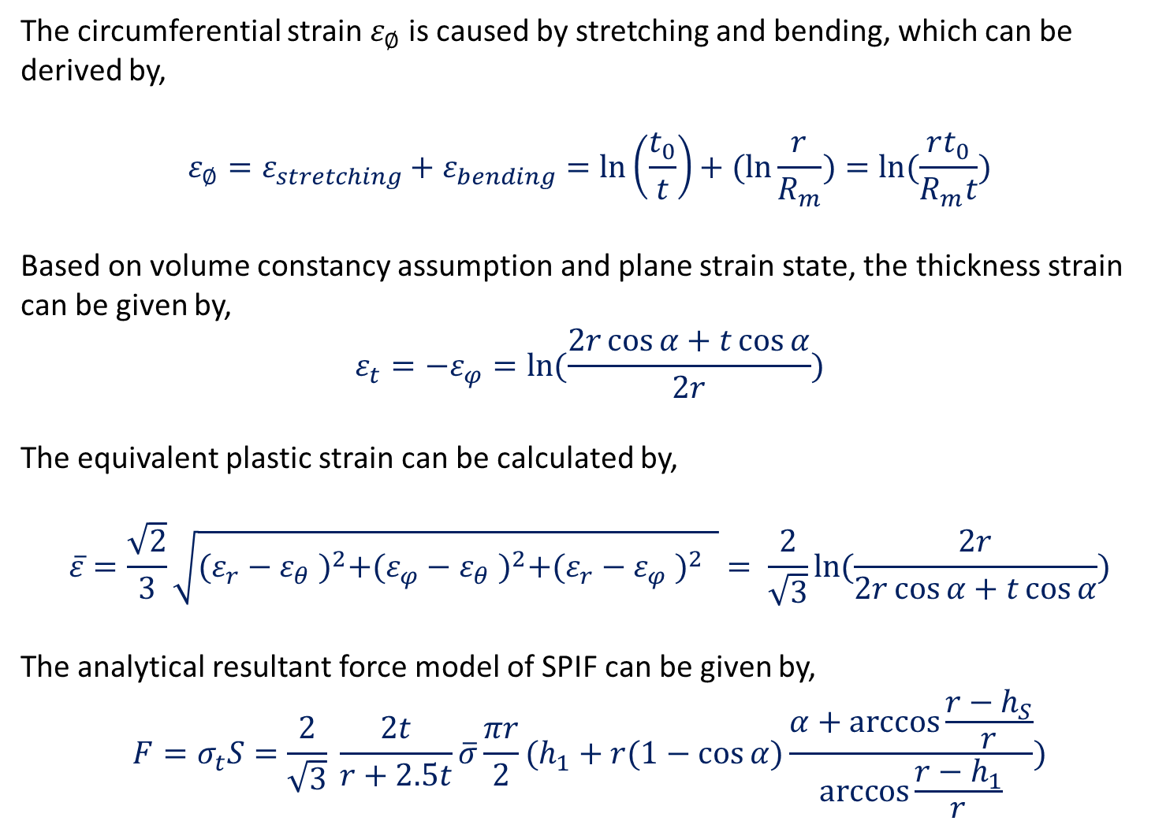
The circumferential strain $ε_{∅}$ is caused by stretching and bending, which can be derived by,
$$ε_{∅}=ε_{stretching}+ε_{bending}=\ln\left(\frac{t_{0}}{t}\right)+(ln{\frac{r}{R_{m}})=\ln{(\frac{rt_{0}}{R_{m}t}}})$$
Based on volume constancy assumption and plane strain state, the thickness strain can be given by,
$$ε_{t}=−ε_{φ}=\ln{(\frac{2r\cos{α+t\cos{α}}}{2r})}$$
The equivalent plastic strain can be calculated by,
$$\overline{ε}=\frac{\sqrt{2}}{3}\sqrt{{(ε_{r}−ε_{θ} )}^{2}+{(ε_{φ}−ε_{θ} )}^{2}+{(ε_{r}−ε_{φ} )}^{2} }= \frac{2}{\sqrt{3}}\ln{(\frac{2r}{2r\cos{α+t\cos{α}}})}$$
The analytical resultant force model of SPIF can be given by,
$$F=σ_{t}S=\frac{2}{\sqrt{3}} \frac{2t}{r+2.5t}\overline{σ}\frac{πr}{2}(h_{1}+r(1−\cos{α})\frac{α+\arccos{\frac{r−h_{S}}{r}}}{\arccos{\frac{r−h_{1}}{r}}})$$

Slide 13
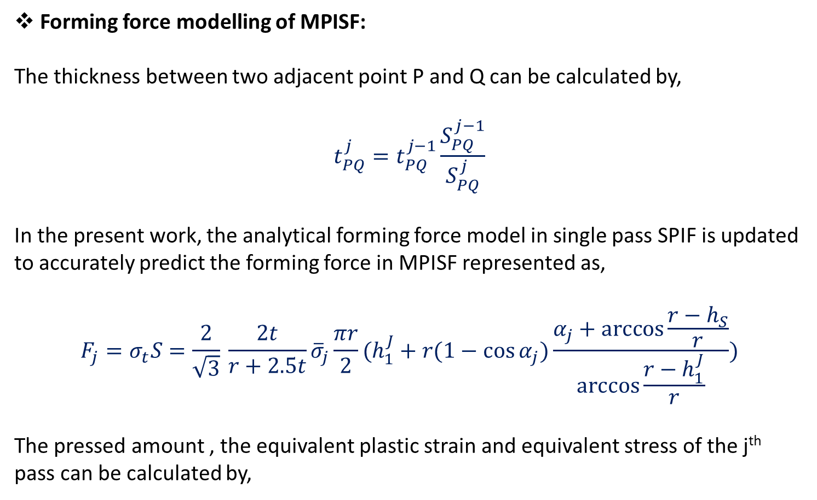
Forming force modelling of MPISF:
The thickness between two adjacent point P and Q can be calculated by,
$$t_{PQ}^{j}=t_{PQ}^{j−1}\frac{S_{PQ}^{j−1}}{S_{PQ}^{j}}$$
In the present work, the analytical forming force model in single pass SPIF is updated to accurately predict the forming force in MPISF represented as,
$$F_{j}=σ_{t}S=\frac{2}{\sqrt{3}} \frac{2t}{r+2.5t}{\overline{σ}}_{j}\frac{πr}{2}(h_{1}^{J}+r(1−\cos{α_{j}})\frac{α_{j}+\arccos{\frac{r−h_{S}}{r}}}{\arccos{\frac{r−h_{1}^{J}}{r}}})$$
The pressed amount , the equivalent plastic strain and equivalent stress of the j^{th} pass can be calculated by,

Slide 14
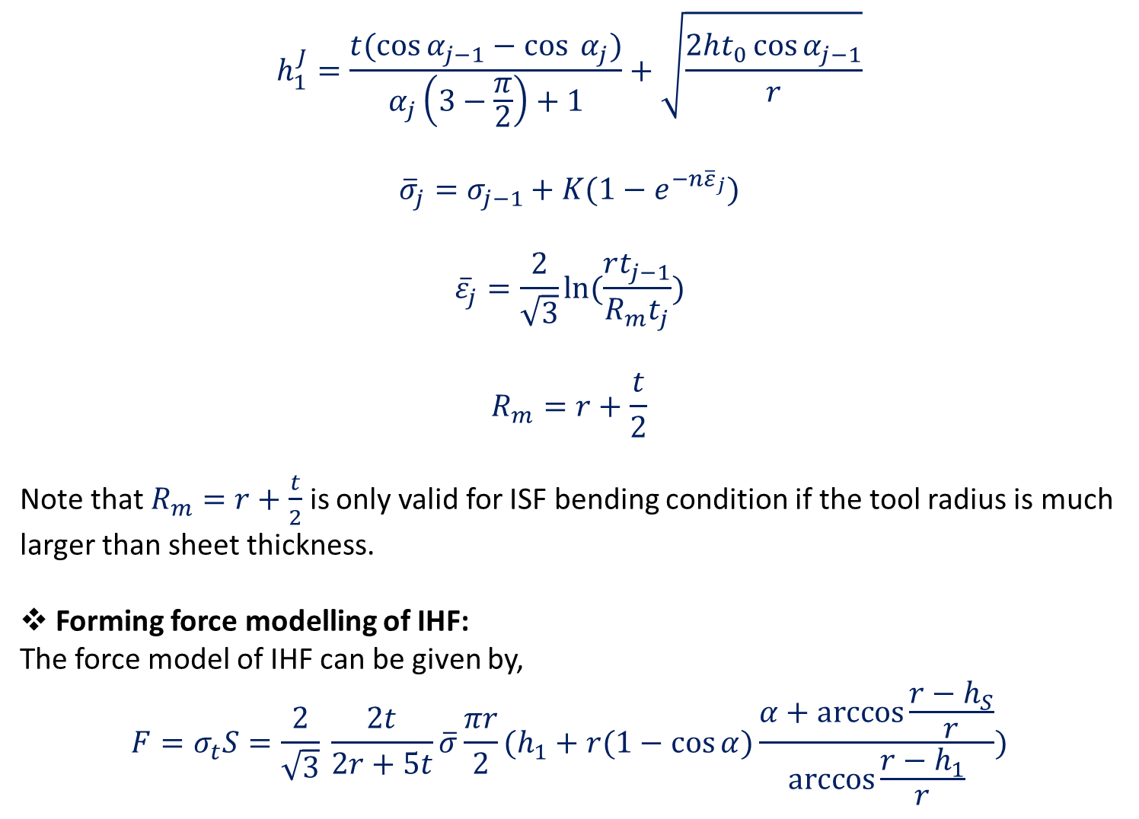
$$h_{1}^{J}=\frac{t(\cos{α_{j−1}}−\cos{ α_{j})}}{α_{j}\left(3−\frac{π}{2}\right)+1}+\sqrt{\frac{2ht_{0}\cos{α_{j−1}}}{r}}$$
$${\overline{σ}}_{j}=σ_{j−1}+K(1−e^{−n{\overline{ε}}_{j}})$$
$${\overline{ε}}_{j}=\frac{2}{\sqrt{3}}\ln{(\frac{rt_{j−1}}{R_{m}t_{j}})}$$
$$R_{m}=r+\frac{t}{2}$$
Note that $R_{m}=r+\frac{t}{2}$ is only valid for ISF bending condition if the tool radius is much larger than sheet thickness.
Forming force modelling of IHF:
The force model of IHF can be given by,
$$F=σ_{t}S=\frac{2}{\sqrt{3}} \frac{2t}{2r+5t}\overline{σ}\frac{πr}{2}(h_{1}+r(1−\cos{α})\frac{α+\arccos{\frac{r−h_{S}}{r}}}{\arccos{\frac{r−h_{1}}{r}}})$$

Slide 15
C++ Code ( Github Link )
The code describes a C++ program that calculates the forming force needed for three metal sheet forming processes, SPIF, MPISF and IHF, using analytical equations that depend on user input parameters such as tool radius and yield stress. The program cautions that the calculated force may not be accurate for all situations and emphasizes the importance of understanding the models' assumptions and limitations before using them in real-world scenarios. The program outputs the calculated force in newtons.
Python Code (GitHub Link )
The code describes a Python program that calculates the forming force for three metal forming processes, SPIF, MPISF and IHF, based on user input parameters such as tool radius and yield stress. The program prompts the user to select the desired process and input necessary parameters. The program calculates the forming force and displays the result. It also allows the user to calculate the forming force for different scenarios with the same or different input parameters. The program provides an error message and terminates if the user inputs an invalid option or input.

Slide 16
Result and Conclusions
Output-
Analytical resulting forming force for SPIF: 1127.94 N
Analytical resulting forming force for IHF: 563.972 N
Analytical resulting forming force for MPISF
Forming force for Pass 1: 1127.94 N
Forming force for Pass 2: 1838.42 N
Input-
Tool radius: 5mm
Initial sheet Thickness: 1.2 mm
Step depth of tool: 0.5 mm
Wall angle: 50 degrees
Material Property ‘K’: 84
Material Property ‘n’: 15
No. of Passes for MPISF: 2
Wall angle for 2nd Pass: 60 degrees
The outputs obtained above matches with the experimental results.

Slide 17
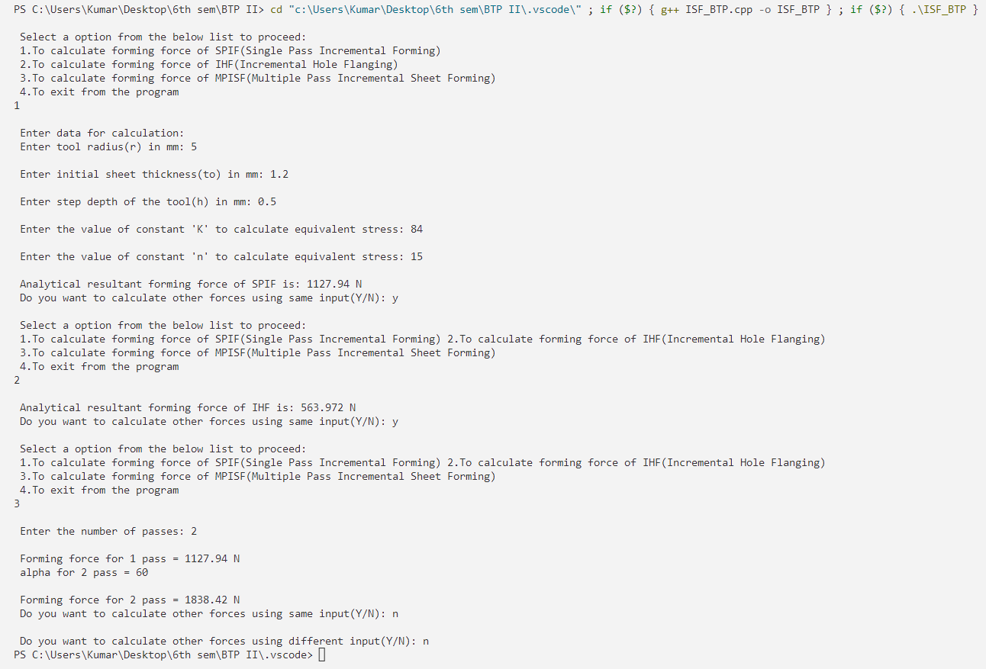
Screenshot of output from VS Code software

Slide 18
Upcoming / Future Work
To study how sheet vibrates under different loads during manufacturing.
To analyze more complicated Boolean Shapes.
Scrap minimization and appropriate material selection from the analysis even at the initial stages of the manufacturing
References
https://www.sciencedirect.com/science/article/pii/S0890695518308691
(Figure 3) M. Silva, M. Skioedt, P. Martins, N. Bay, Revisiting the fundamentals of single incremental forming by means of membrane analysis Int. J. Mach. Tool Manuf., 48 (2008), pp. 73-83

Slide 19

TO BE CONTINUED IN BTP PHASE 3 ….

